Slide 1




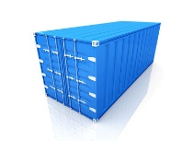
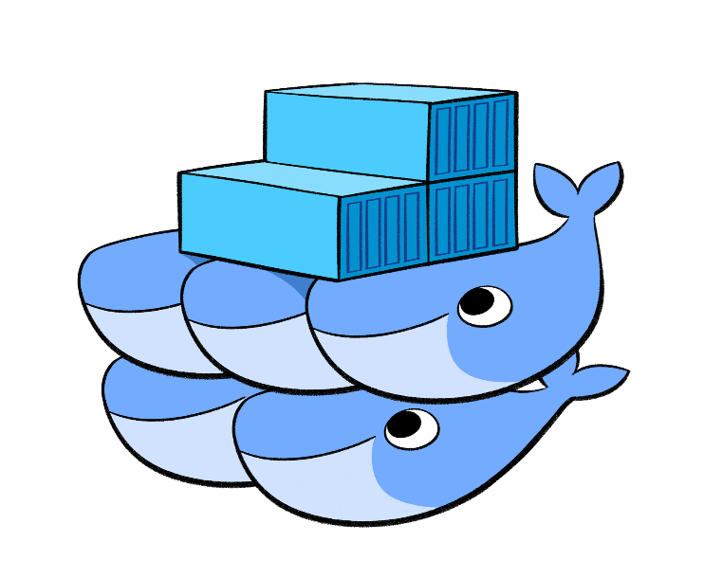



Developer
Local Code
Source Control
DockerHub
push
pull
build
Consumer
Docker Image
Expose endpoint
pull
Docker Swarm
Manager
Administrator
Cloud Provider
Provision Swarm
Worker
Worker

